Slide 1
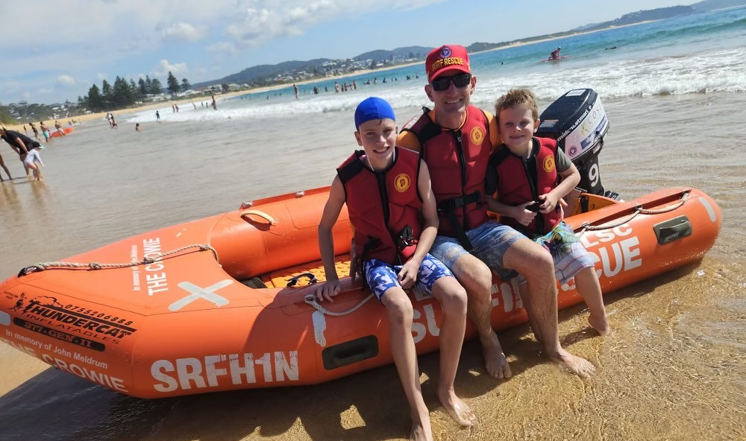
Terrigal Surf Lifesaving Club Nipper Information Booklet 2024-2025

Slide 2
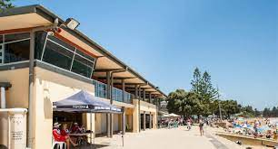
Welcome to Terrigal Nippers
Thank you for choosing our club to develop your child’s lifesaving skills in our nipper program.
Terrigal Surf Life Saving Club is committed to providing children with confidence, skills and an understanding of the beach and surf environment through our Junior Activities - Nipper Program.
We strive to provide a program that is fun, family friendly and focused on developing each of our nippers throughout the season.
Our aim is to give our nippers the skills, training, and environment to become excellent lifesavers of the future.

Slide 3
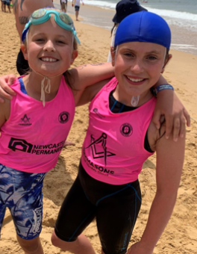
What is the Nippers program?
Nippers participate in a progressive Surf Life Saving Australia Education program, providing them with the skills and knowledge of beach safety, rescue techniques and basic first aid.
The nipper program runs each Sunday morning from mid-October depending on weather, surf conditions and the availability of volunteers. Terrigal Surf Club generally has around 250 nipper members spanning the Under 6 – 14 age groups.
Depending on the age group, activities may include a wade, board paddling, swimming, beach sprinting, long distance runs and beach flags, as well as lots of fun activities and games designed to develop surf and rescue skills.
Nippers can start from 5 years old. The first year/s use fun and games on the beach to introduce children to basic skills and awareness of where to swim and what help is available from lifesavers.

Slide 4
Membership Type | Description | Amount
Little Nipper | Under 6’s and 7’s | $100
Nipper | Under 8’s to 14’s | $100
Family package | All residing at the same address. Does not include education, carnival ley or gym membership | $390
Dual club membership | Active member from another club joining Terrigal S.L.S.C (competition) | $80
Dual club membership | Active member from another club joining Terrigal S.L.S.C (non-competition) | $50
Associate member | A parent / guardian of a joining nippers, or someone who acts in the capacity of official, age manager or similar position | $100
Community member | Member not directly participating in lifesaving activities. May cover social or volunteer activities and entitles member to use club facilities in line with governance obligations | $200
Active member | Holder of Bronze Medallion, Surf Rescue Certificate or other SLSA award who completes requal and required patrol hours each year. | $80
Renewals | Little Nipper, Nipper and Associates | $90
Renewals | Active member | $70
Renewals | Family of 4 person | $350
Renewals | Family of 5 person | $340
Renewals | Family of 6 person | $330
Annual Nippers fees for 2024/2025

Slide 5
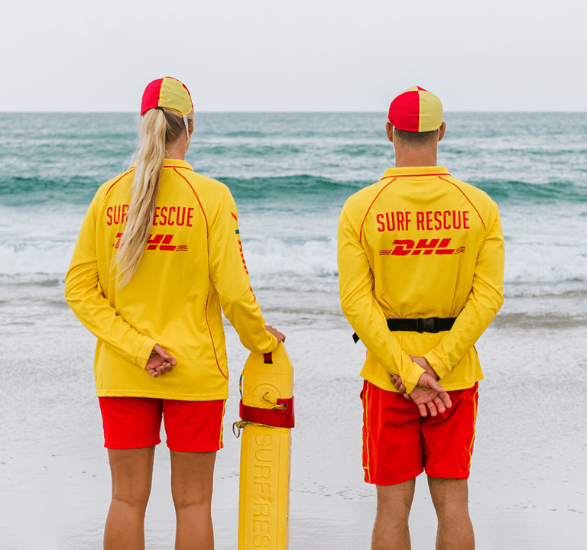
Registration
To participate in Nippers, registration and payment must be completed prior to attending. Membership is managed in conjunction with Surf Life Saving Australia, through and online members portal. For a nipper/s to be registered, at least one parent/carer must also register as a member with Terrigal Surf Life Saving Club.
Access the Surf Life Saving Australia Members portal at https://members.sls.com.au
All registrations, new and renewing for another season, must be processed through the portal.
All members require an individual login, and following, can be grouped into a family to administer as a group.
If you encounter a problem with your account, request help through the support desk at https://support.sls.com.au/open.php or call 1300 724 006.
Our local club registrar is Beris Meldrum and can be contacted via registrar@terrigalsurfclub.com.au
Registration will not be finalised until payment is made and/or identification for new members is provided/sighted and a parent/carer is registered.

Slide 6
Age Groups
Age Groups
Group | DOB Period
U6’s | 1 Oct 2018 to 30 Sept 2019
U7’s | 1 Oct 2017 to 30 Sept 2018
U8’s | 1 Oct 2016 to 30 Sept 2017
U9’s | 1 Oct 2015 to 30 Sept 2016
U10’s | 1 Oct 2014 to 30 Sept 2015
U11’s | 1 Oct 2013 to 30 Sept 2014
U12’s | 1 Oct 2012 to 30 Sept 2013
U13’s | 1 Oct 2011 to 30 Sept 2012
U14’s | 1 Oct 2010 to 30 Sept 2011
Children can join Nippers from Under 6’s through to Under 14s. A child may join Nippers once they turn 5 years old. We cannot take registrations from any child who is not 5 years old by 30 September 2024.
The first year/s use fun and games on the beach to introduce children to basic skills and awareness of where to swim and what help is available from lifesavers.
At times kids may want to join age groups above or below their birth date designated age group to be with friends or seeking different skill levels. We encourage kids to join their actual age group to meet and make new friends, assisted by the age manager.
The competition age for nippers is determined by the age the child is on September 30 of the current season.
Proof of age must be sighted for new members under 14.

Slide 7
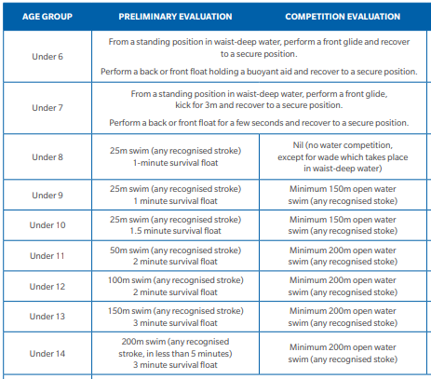
Preliminary and competition evaluation
It is the requirement of Surf Lifesaving Australia that prior to participation in the Nippers program each season, that all Nippers must complete a preliminary skills evaluation.
For all Nippers from Under 8s to Under 14s who wish to participate in junior life saving carnivals, will also be required to complete a competition swim evaluation.

Slide 8
Age Managers
Age Group | Girls | Boys | WhatsApp QR codes
Under 6’s
Under 7’s | Beris Meldrum /
Under 8’s | Craig Young / Candice Mungovan
Under 9’s | Campbell Lemmon
Under 10’s |  | Sam Rawlings
Under 11’s | Evan Griffiths / Jemma Hall
Under 12’s | Laura Stone | Adam Montgomery
Under 13’s | Scott Roberts /
Under 14’s | Alana Tyrrell | Lisa Metcalfe
The Age Manager of your child’s group will be your primary liaison point for all things nipper related. They play an important role in the running of the nipper program and will be actively involved with their group’s activities.
Please introduce yourself, they are visible in their blue long sleeved Age Manager shirt and can assist you with any concern or query.
Below are the volunteer Age Managers for each age group for this upcoming season. In the last column is the QR code to join the groups WhatsApp chat. Please join the group early and be sure to post saying Hi, including who your child is.

Slide 9
Day one at Nippers
Our Sunday Nipper program starts on Sunday 13 October 2024 for all age groups.
If you are new to Nippers or Terrigal Surf Club, we recommend you arrive 25 minutes before start time so that you can find a park, grab a coffee, pop on sun-cream on and get your child ready to go!
Under 6 and 7’s: 8am start
Under 8’s to Under 14’s: 8:30am start
For new members and especially for the new Under 6’s, there can be lots of nerves including getting into the water. Reassure your kids letting them know that they will be playing games and doing activities most of which will take place on the sand. Depending on their confidence and the conditions, we’ll include water based activated up to the level they feel comfortable - there will be no pressure, only reassurance.

Slide 10
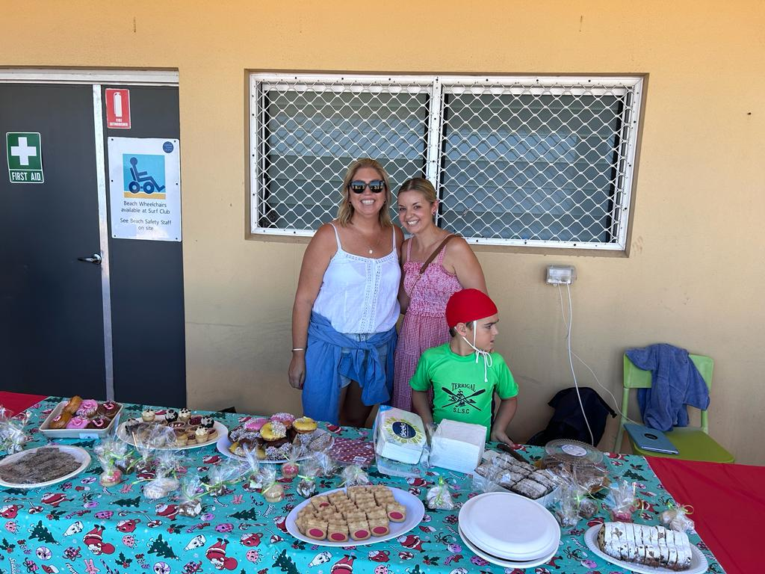
Your role as a parent / carer
WAYS OF GETTING INVOLVED…
Age Manager, Assistant Age Manager
Water Safety, IRB crew/driver
Official/Coach
Assist coaches with training
Setting up the beach and putting equipment away
BBQ helper
Fundraising, etc
YOU DO MAKE THE DIFFERENCE!
One thing we can tell you for certain, the more YOU get involved, the more you and your child will enjoy Nippers.
The main emphasis of Nippers is to have fun in an all-inclusive environment.
Our club relies on volunteer help. There are many jobs you can help with, and you do not need to have had surf life saving experience or be a lifesaver. The club values any and all contributions from parents – it makes our club. BE PART OF THE FUN – GET INVOLVED

Slide 11
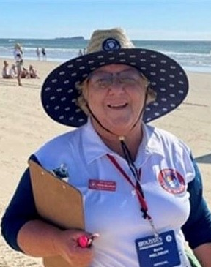
Parent / Carer commitments
Non-competitive Nippers – Nippers who attend Sunday Nippers only.
The minimum parent commitment is TWO Sunday morning contributions or hold a JAC Committee position per nipper.
Competitive Nippers – Nippers who compete at Carnivals (Under 8 age group and above).
In addition to volunteering at TWO Sunday morning Nippers, the minimum commitment is that parents are willing and able to support the age manager and their child.
We would ask that each parent whose child competes at a carnival be prepared to be Water Safety (must hold an SRC or a Bronze medallion) or act as Official.
If each parent commits and takes on a role – we share responsibility and do not see the same volunteers doing all roles week in week out. As mentioned, this is a volunteer organisation – age managers, parent coaches and JAC committee members are unpaid.

Slide 12
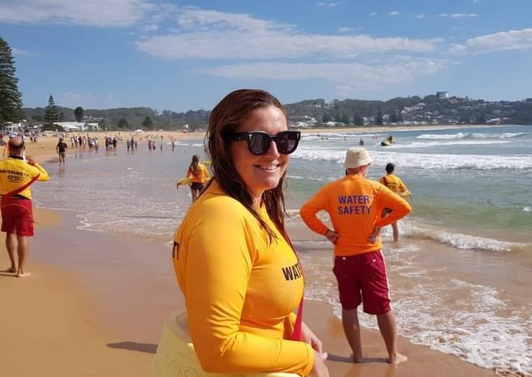
Water Safety and Officials
Officials
A ‘Carnival Officials’ course is available for parents who would like to get involved at our Competition Carnivals that we will attend each season. This is the chance to get a ringside seat at the action! Without Officials from our Club, we are not allowed to compete at carnivals.
For each 10 competitors, at a minimum we must supply an accredited Official from our Club.
You don’t have to complete an official’s course to help at local carnivals.
Water Safety
At the beginning and throughout the season training is available for any parent interested in obtaining their Bronze Medallion. Many parents who complete their Bronze will enjoy the learning experience whilst improving their fitness and getting a greater understanding of surf lifesaving.
Our Club must meet the water safety requirements listed by Surf Life Saving Australia. It is therefore essential that as many parents as possible obtain their Bronze Medallion to assist with water safety. If we do not have the required number of Water Safety Officers then surf events cannot be conducted, whether at a normal nipper day, carnivals or club training sessions.
For more information on the carnival officials' course, or obtaining your Bronze Medallion, please speak with your child’s Age Manager.

Slide 13
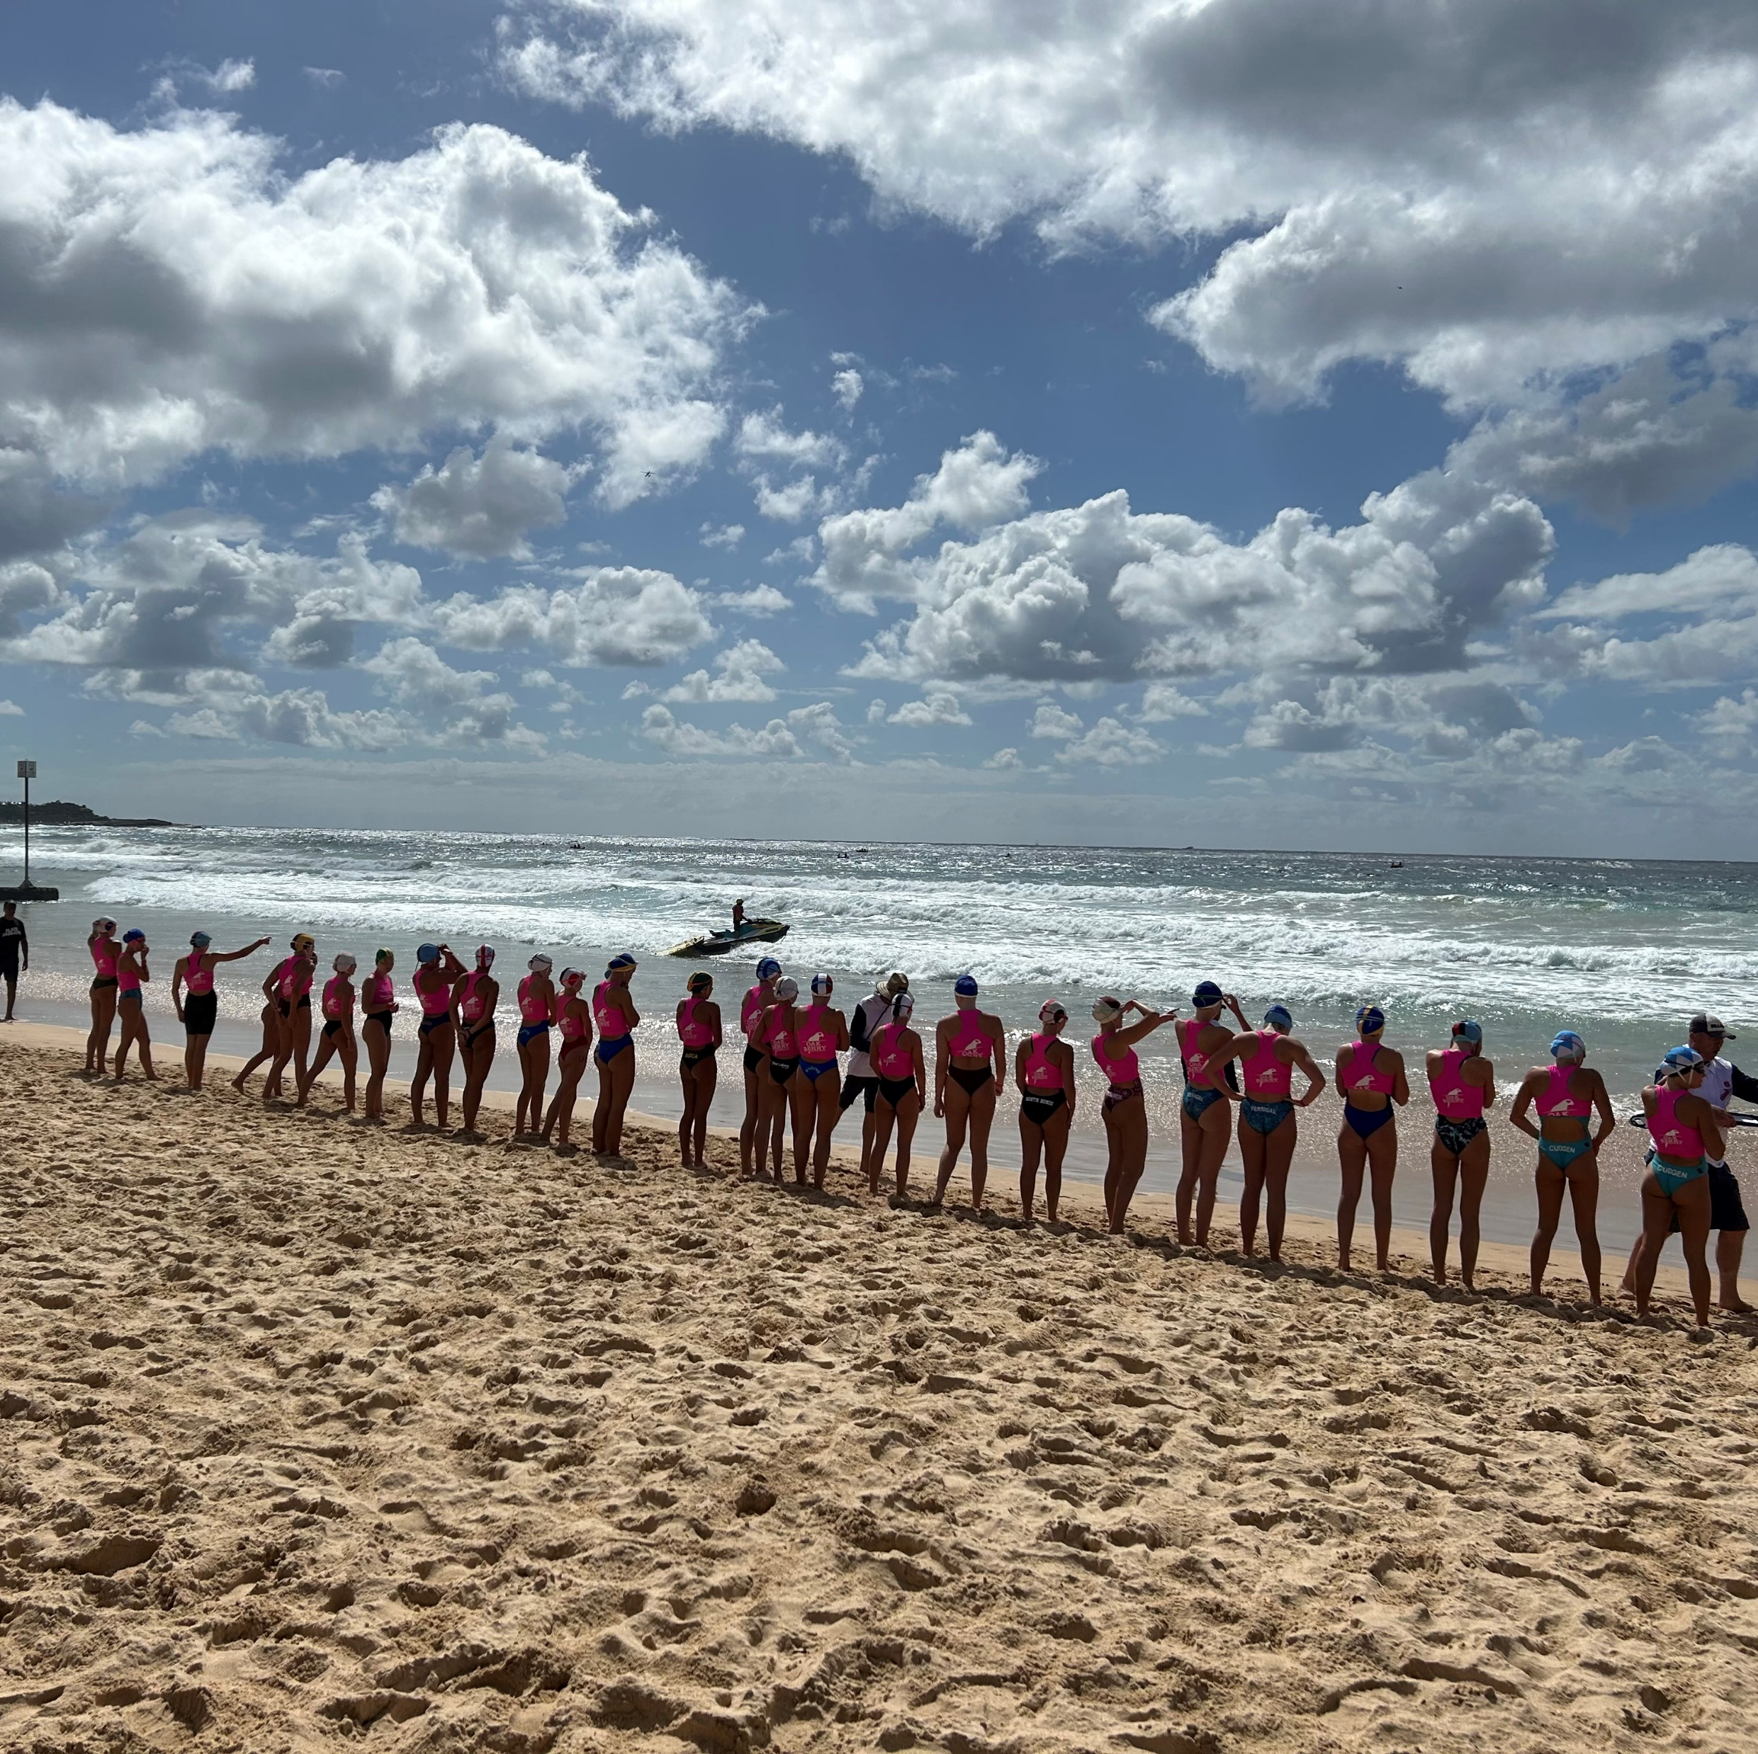
Nippers carnivals
Throughout the season, junior surf lifesaving carnivals are held at various locations around the Centra Coast. Using the skills learned and developed though the regular Sunday mornings and mid-week coaching, our nipper athletes can participate and test their abilities against other surf life saving clubs.
Nippers of all abilities will be encouraged to attend carnivals, however attendance is optional. They are a great stage for showcasing our athlete talent and spirit.
Carnivals comprise of individual and team events. Team selections are made in accordance with the competition policy on the Terrigal Surf Club website.
For carnival events to run, each surf club is required to provide volunteers in officiating and water safety duties. This can result, at times, where you may not see your child compete in all their races. However, without the volunteer support, simply, the carnivals cannot be held. Expectations of parent contributions are detailed later in this booklet.
Carnivals can be long days and it’s not always possible to compete in all events due to clashes within the timetables.

Slide 14
Terrigal Club Championships
Terrigal Surf Club run Club Championships 3 times per year for under 8’s to under 14’s. Club Championships is an inter-club competition where nippers are competing individually against other nippers in their age group.
The results from all three club championship rounds are combined and will determine the age champion winners at the end of the year.
The results will also be used to form teams at carnivals.
Events for club championships are:
Under 8’s – Sprint, Flags, Wade
Under 9’s and under 10’s – Sprint, flags, swim, board
Under 11’s to under 14’s – Sprint, flags, swim, board, ironperson, distance run (under 11’s and 12’s – 1km, Under 13’s and Under 14’s 2km)

Slide 15
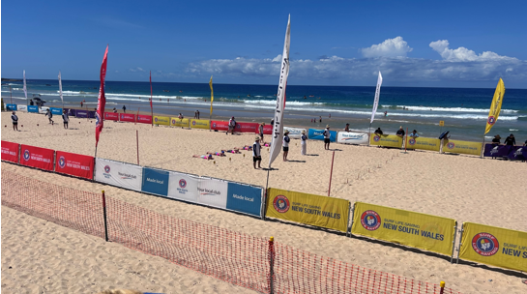
Junior Surf Life Saving NSW Age Championship
The Junior Surf Life Saving NSW Age Championship (the State Nipper Carnival) is the major Surf Life Saving competition for Nippers each season. The State Nipper Carnival attracts nipper competitors from all over NSW and runs over 4 consecutive days (Thursday - Sunday). For the 2024-2025 season, it will be held at the Northern Beaches in Sydney.
Nippers from U9’s through to U14’s can compete.
Fulfilling club volunteer requirements at the State Championships is always challenging, especially with multiple days of competition being conducted on weekdays and / or weekends. Areas at the State Championship requiring parent contributions include: Carnival Officials, IRB drivers and crewpersons, First aid officers, water safety.
For Nippers who compete at the State Championships, parents or guardians must volunteer in one of the above roles if they do not hold another volunteering position with the club.
Click here for the 2024-25 Nippers calendar for date.

Slide 16
Australian Surf Life Saving Championships ‘Aussies’
The Aussies is an annual event where members from Australia’s 314 Surf Clubs come together to compete in more than 480 beach and ocean events.
The 2025 Australian Surf Life Saving Championships will be held on the Gold Coast, Queensland at North Kirra SLSC and Tugun SLSC from 29 March – 6 April.
Aussies is open to Nippers from Under 13’s and above. Nippers do not need to qualify for events to attend.

Slide 17
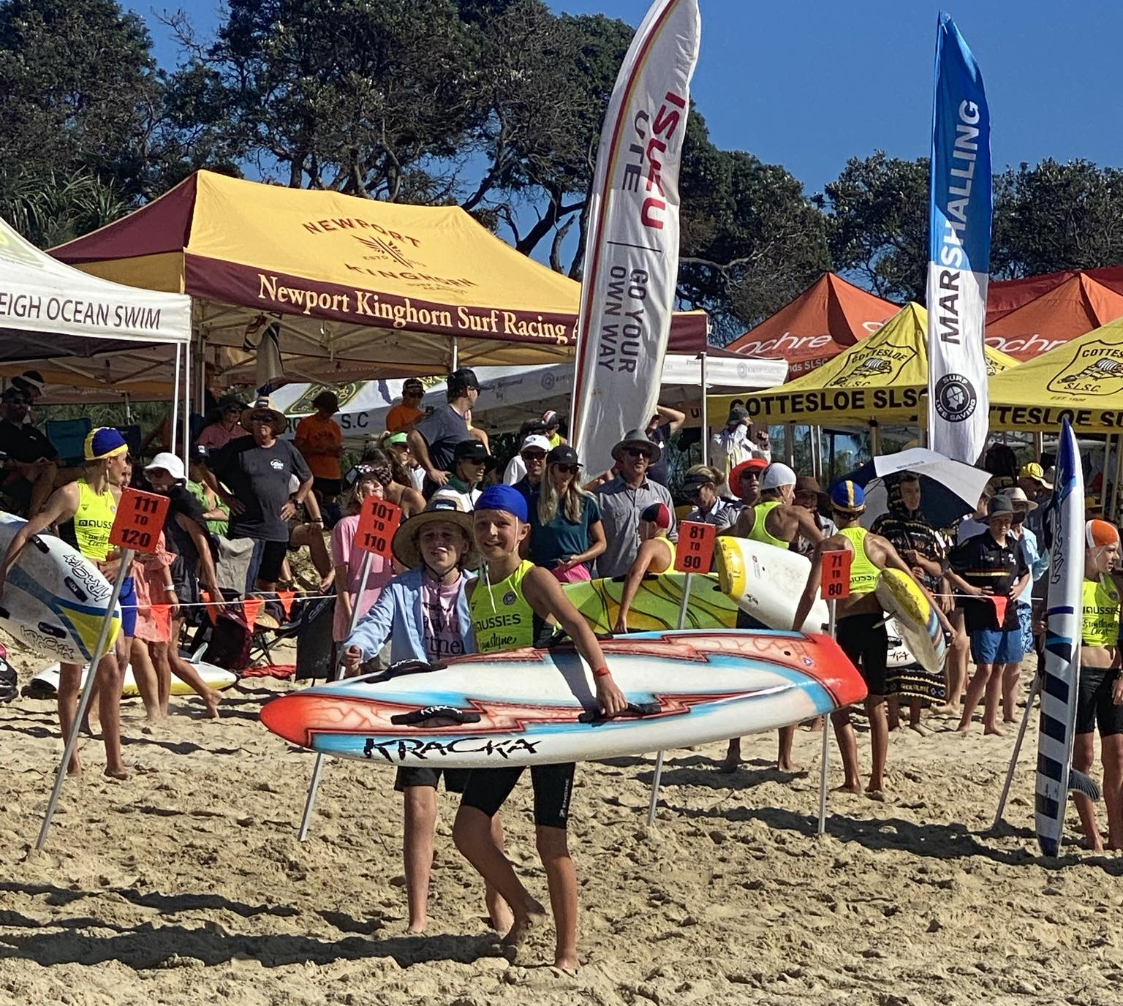
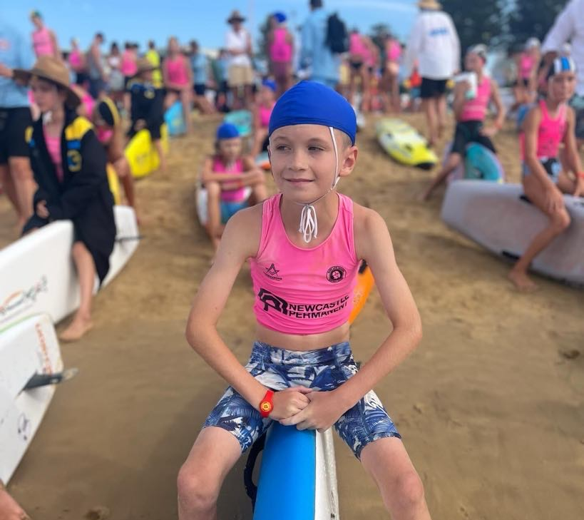
2024-25 Terrigal Nippers Calendar
The link to the Terrigal Nippers 2024-25 calendar is below.
This document and will outline all Nippers events including regular Sunday nippers, club championships carnivals, and other Nippers activities.

Slide 18
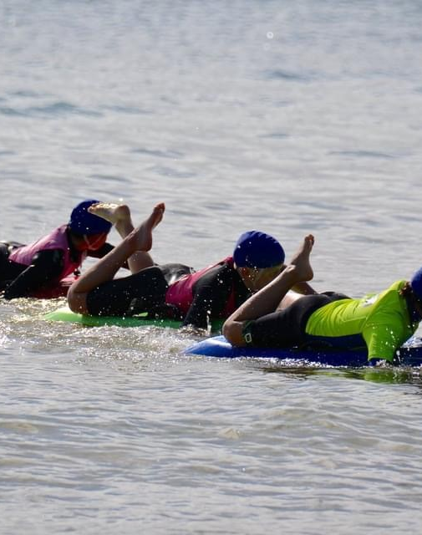
Coaching
Terrigal prides itself on our free in season and extensive club coaching program, with board, surf and beach training available, for Under 9’s through to the senior club. Our qualified and experienced coaches will develop your child’s skills in these areas.
The coaching program is open to every Terrigal Nipper regardless of experience. Sessions are targeted at developing skills and fitness in preparation for carnival competition. To participate, Nippers must be financial and have completed the preliminary proficiency. This is an annual requirement for all Nippers, new and returning. Every child must complete their proficiency float and competition swim as instructed.
The coaches are not swim instructors and are unable to focus one on one to provide basic swim skills to Nippers. If your child is not a confident swimmer it is recommended that they attend swim classes or squads to build their skills and competency.

Slide 19
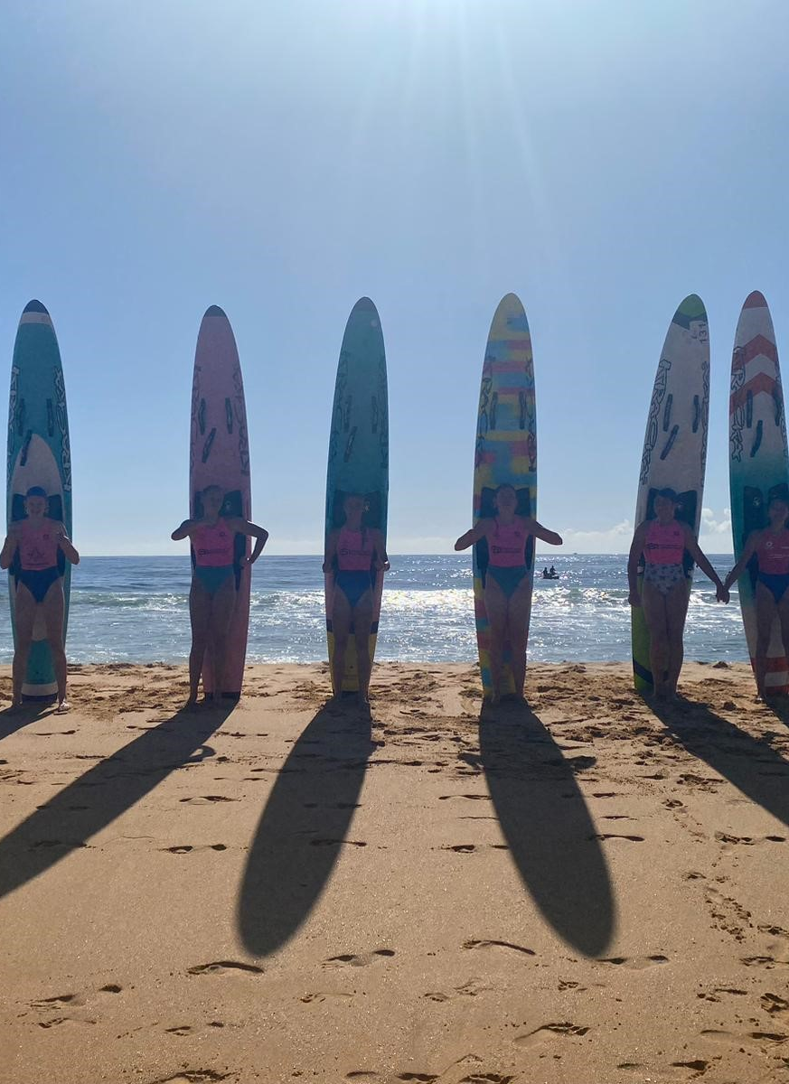
Nippers Training
Assessment - New Nippers are required to attend the Beginners Foam/Water Sessions for assessment prior to attending any other coaching session.
Group Assignment - Nippers might not be with friends their own age until they reach a minimum level of competency. Safety is paramount and coaches require participants of similar capability to ensure training can be safely and effectively delivered.
Timing - At the conclusion of training, parents must be ready on the beach to assume responsibility for their kids – especially should they choose to remain in the water. Training sessions will run to time as many of the coaches are surf sports competitors with their own training sessions to attend.
Safety - A high visibility singlet or rashie must be worn during training sessions. This is a mandatory SLSA safety requirement. Nippers will not be allowed to train if they do not have a high visibility singlet.
Parent Assistance - In addition to the coaching staff, parent water safety is required, especially for beginner board. Kids as this age often require one on one support, especially from their parents as they can be very nervous in the water. If you are not prepared to get in the water or are unable let your coach know prior to the session.
Communication - All correspondence in relation to coaching will be via Facebook/WhatsApp groups – check with the Trainer at the first session for these details.

Slide 20
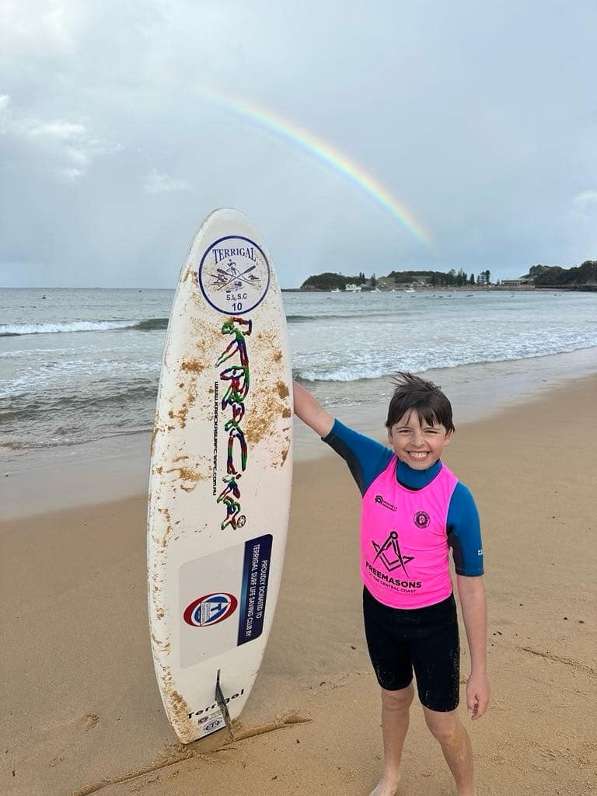
Terrigal Surf Club boards
Our club has a selection of fibreglass and foamie boards for those children that do not have their own craft. Please also note:
Don’t touch other athletes' boards. They are expensive craft and if you damage another’s property, it’s expected you will be accountable for the repair.
If the board has a Terrigal sticker on it, it is a club board. These boards should ONLY be taken out in the water by members of Terrigal Surf Club. Members are not permitted to provide craft to non-members. Only our members are covered by insurance.
If you take a board out of cage for training at the end of the session promptly wash the board off and put back in cage. Do not leave on the beach for someone else to do.
If you need a board for a carnival, you can attend training on a Friday afternoon and sign a board out for the weekend. We will collect details of those taking the boards. If your child is not attending training on the Friday, someone will need to come and collect the board on your behalf. We cannot sign club boards out prior as craft is used for training. Boards must be returned after the carnival from 5pm.

Slide 21
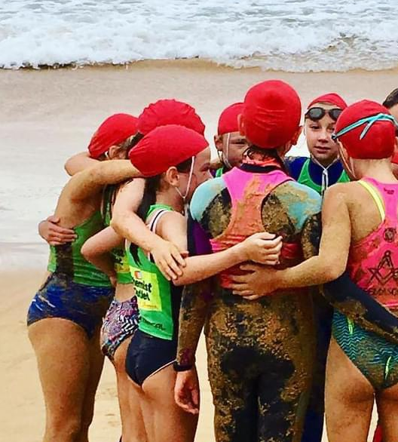
What to wear
Children can wear any type of swimmers to Nippers. Some Nippers choose to wear Terrigal Surf Club swimmers which can be ordered online at www.fashionfish.com.au
At regular Sunday Nippers, kids can wear a wetsuit will help to stay warm, especially at the start of the season. Unfortunately, wetsuits cannot be worn during Club Championships or at carnivals.
All new Nippers will receive a coloured Nippers cap at the first attendance. The colour is specific to their age group and will be their age colour as the group progresses each year. New Nippers in the younger age groups will also receive a rash vest.
Any returning nippers that need a new cap can purchase a new one from the club.
If you choose to compete at carnivals, all Nippers must wear the royal blue coloured Terrigal Club cap. This is to be purchased separately for $10.

Slide 22
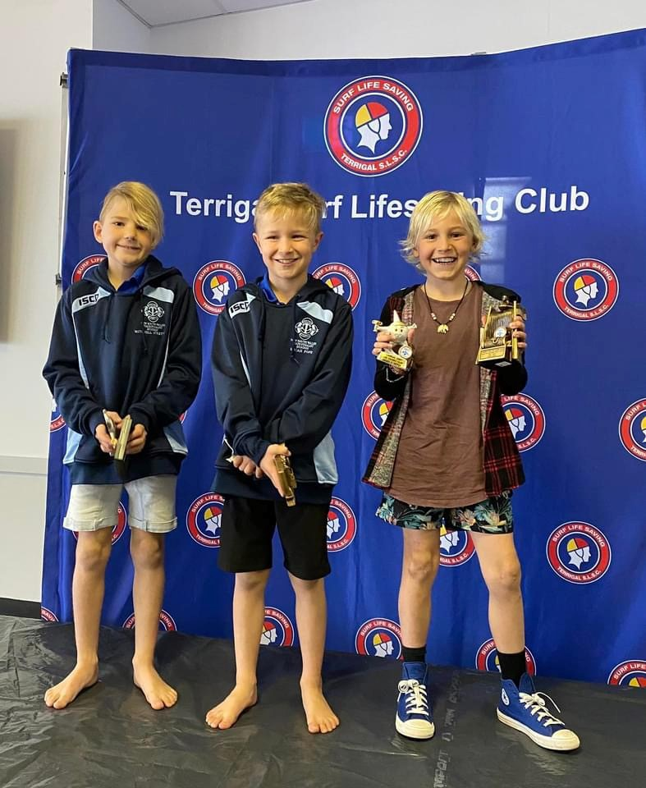
Awards and presentations
After each carnival, a presentation is held back at the surf club in the evening, known as sips. This presentation is not just for children receiving medals. It is a great opportunity to celebrate all achievements and mingle with other competitors and parents.
At the end of each season, we recognise the efforts of our junior members at two separate award presentations. One for the U6s, U7s, and a separate presentation for the U9s to U14s groups. In the presentation for U8’s and above, the age champions winners are announced at this presentation. A number of other awards are also given out, including encouragement awards.

Slide 23
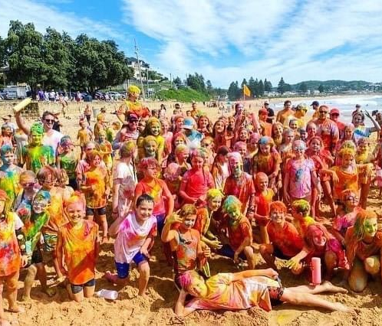
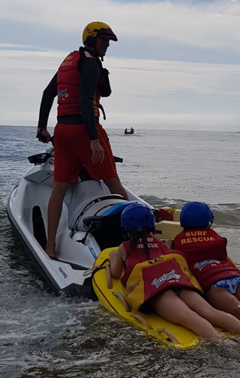
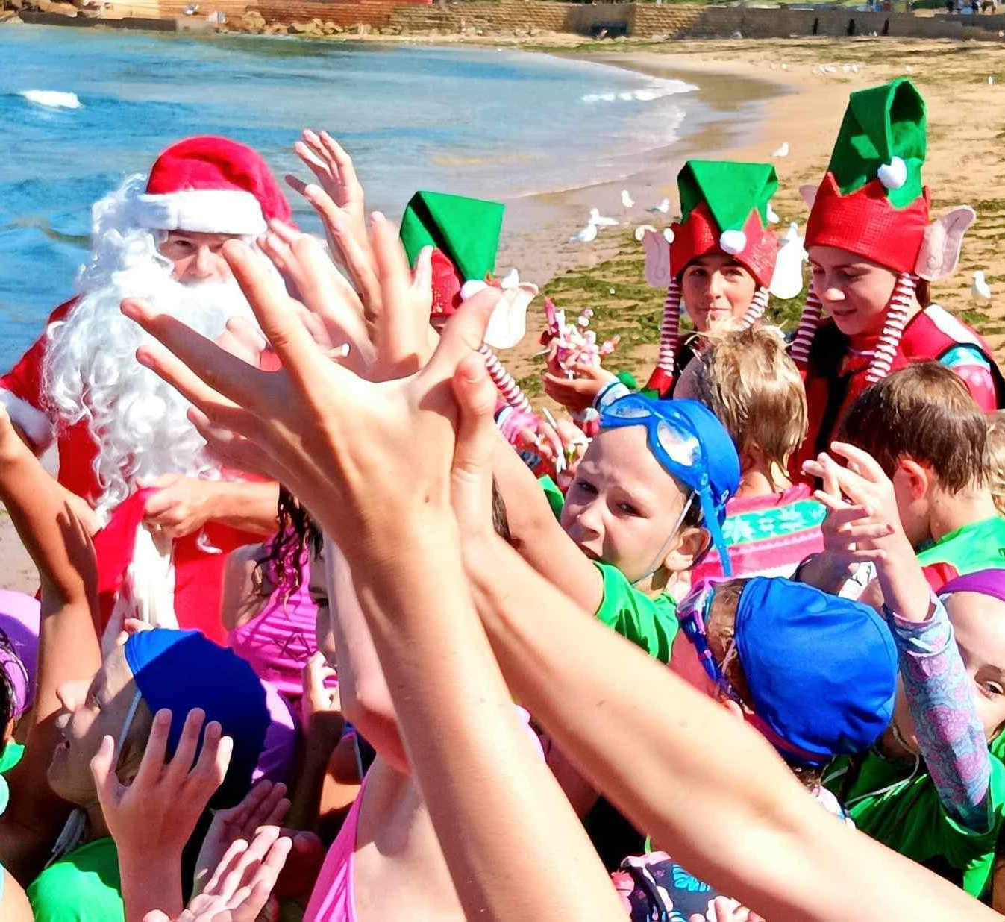
Other Nippers events
Throughout the year, Terrigal Surf Lifesaving Club organises a number of fun activities for our Nippers.
Some of these include our annual colour run, twilight Christmas nippers and rescue day.

Slide 24
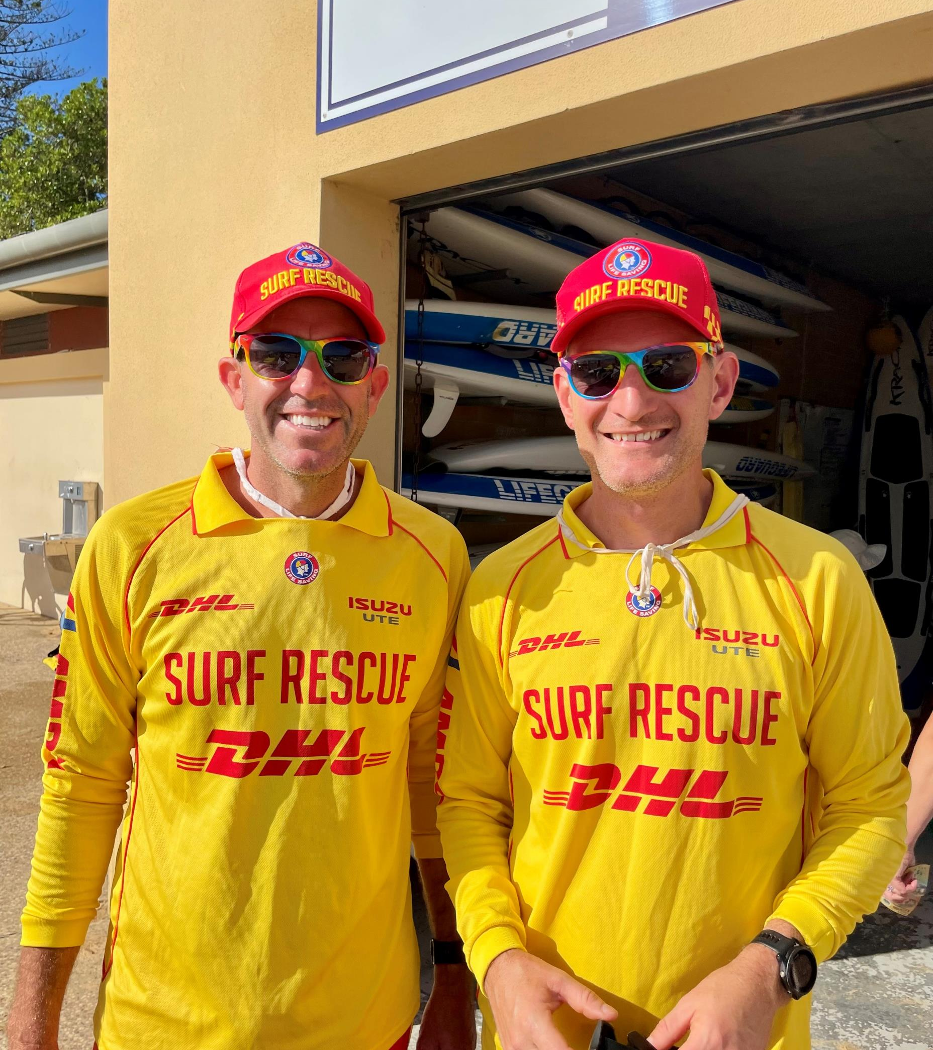
Junior Activities Committee (JAC)
Director of Junior Activities
Scott Roberts
Deputy Director
Mark Cameron
Junior Coaching Coordinator
Hayden Cowan
Events & BBQ Coordinator
Simone Robertson
Age Managers
Refer to table

Slide 25
Terrigal S.L.S.C Board of Directors
As a registered nipper, and the registered parent / carer, you are members of Terrigal Surf Life Saving Club. Within the membership, are several director roles, which are responsible for the functions as detailed below.
President Richard Green president@terrigalsurfclub.com.au
Director of Life Saving Tim Pittolo lifesaving@terrigalsurfclub.com.au
Director of Competition Richard Green competition@terrigalsurfclub.com.au
Director of Education Cheryl Wallace education@terrigalsurfclub.com.au
Director of Member Services Danielle Quick membership@terrigalsurfclub.com.au
Director of Junior Activities Scott Roberts nippers@terrigalsurfclub.com.au
Director of Sponsorship Ben Hibberd sponsorship@terrigalsurfclub.com.au
Director of Finance Beris Meldrum finance@terrigalsurfclub.com.au
Director of Administration Julie Redfern admin@terrigalsurfclub.com.au

Slide 26
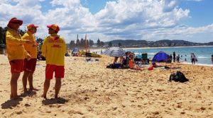
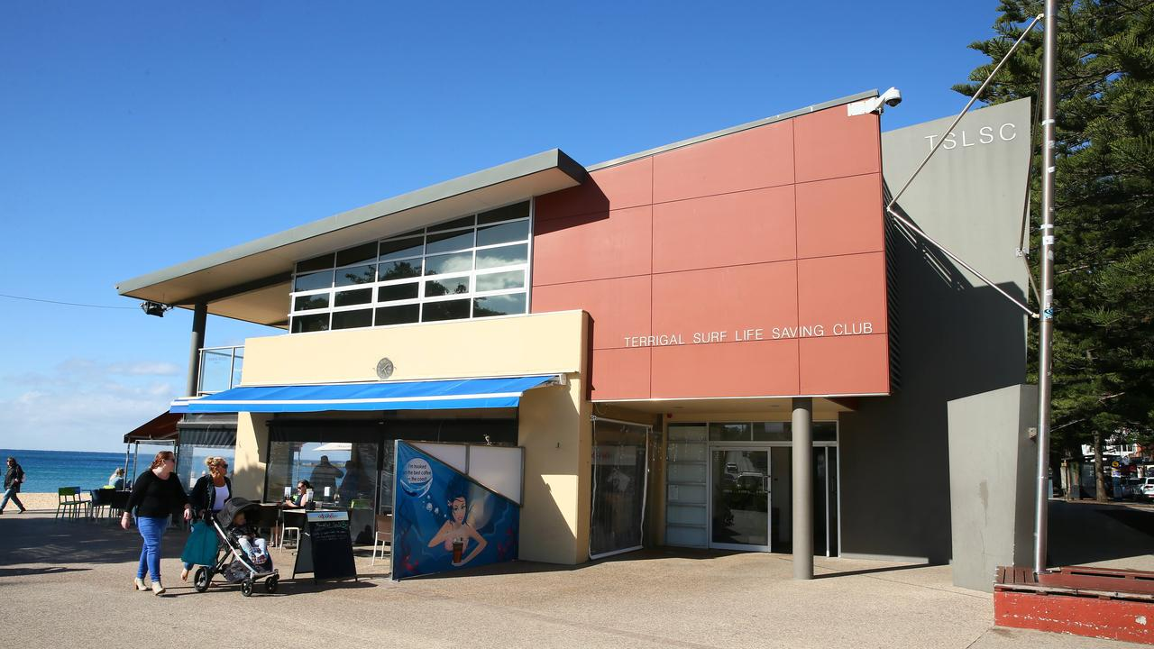
Club Contact Information and News
Phone: 02 4385 6933
Email: office@terrigalsurfclub.com.au
Website: https://terrigalsurfclub.com.au/
Address: Terrigal Surf Life Saving Club, PO Box 57, Terrigal NSW 2260
Socials: “Terrigal Surf Life Saving Club” | “Terrigal Nippers” | @terrigalslsc
Blues News Email: Keep an eye out for ‘Blues News’, our primary member email bulletin.
Surfguard SMS: At times important info will be sent via mobile SMS.

Slide 27
Proudly supported by our partners
Thank you to our generous sponsors!

